Slide 1
Data Mining Unit-I: Introduction to Data Mining
Dr.G.Padmavathi Associate professor CRRAO AIMSCS

Slide 2
Course Overview
Credits: 3 (L-T-P: 3-0-0)
Pre-requisites: Database Management Systems
Probability and Statistics
Goal: Introduce key data mining techniques & their applications

Slide 3
Data Mining Syllabus
UNIT - I
Introduction to Data Mining:
What Data mining? Kinds of Data, Knowledge Discovery process, Data Mining Functionalities, Kinds of Patterns, Major Issues in Data Mining. Data Objects and Attribute Types, Basic Statistical Descriptions of Data, Data Visualization, Measuring Data Similarity and Dissimilarity, Data Pre-processing: Major Tasks in Data Pre-processing, Data Cleaning, Data Integration, Data Reduction, Data Transformation and Data Discretization.
UNIT - II
Association Analysis: Basic Concepts, Market Basket Analysis, Apriori Algorithm, FP-growth, From Association Analysis to Correlation Analysis, Pattern Mining in Multilevel Associations and Multidimensional Associations.
UNIT - III
Classification: Basic Concepts, Decision Tree Induction, Bayes Classification Methods, Rule-Based Classification, Metrics for Evaluating Classifier Performance, Ensemble Methods, Multilayer Feed- Forward Neural Network, Support Vector Machines, k-Nearest-Neighbor Classifiers.
UNIT - IV
Cluster Analysis: Requirements for Cluster Analysis, Overview of Basic Clustering Methods, Partitioning Methods-k-Means, k-Medoids, Hierarchical Methods-AGENES, DIANA, BIRCH, Density- Based Method-DBSCAN, Outlier Analysis: Types of Outliers, Challenges of Outlier Detection, and Overview of Outlier Detection Methods
UNIT - V
Advanced Concepts: Web Mining- Web Content Mining, Web Structure Mining, Web Usage Mining, Spatial Mining- Spatial Data Overview, Spatial Data Mining Primitives, Spatial Rules, Spatial Classification Algorithm, Spatial Clustering Algorithms, Temporal Mining- Modeling Temporal Events, Time Series, Pattern Detection, Sequences, Temporal Association Rules.

Slide 4
TEXT BOOKS:
Jiawei Han, Micheline Kamber, Jian Pei., Data Mining: Concepts and Techniques, 3rd Edition, Morgan Kaufmann/Elsevier, 2012.
Margaret H Dunham, Data Mining Introductory and Advanced Topics, 2nd Edition, Pearson Education, India, 2006.
REFERENCE BOOKS:
Data Mining Techniques, Arun K Pujari, 3rd Edition, Universities Press.
Pang-Ning Tan, Michael Steinbach, Anuj Karpatne and Vipin Kumar, Introduction to Data Mining, 2nd Edition, Pearson Education India, 2021.
Amitesh Sinha, Data Warehousing, Thomson Learning, India, 2007.

Slide 5
UNIT - I Introduction to Data Mining
What Data mining?
Kinds of Data,
Knowledge Discovery process,
Data Mining Functionalities,
Kinds of Patterns,
Major Issues in Data Mining.
Data Pre-processing:
Major Tasks in Data Pre-processing,
Data Cleaning,
Data Integration,
Data Reduction,
Data Transformation and Data Discretization.
Data Objects and Attribute Types
Basic Statistical Descriptions of Data,
Data Visualization,
Measuring Data Similarity and Dissimilarity,

Slide 6
Unit I: Introductionto Data Mining
Data mining definitions, goals, and processes
Types of data, patterns, and issues
Data visualization, similarity measures
Data cleaning, integration, transformation

Slide 7
Why Data mining?
Data is a collection of raw facts, figures, or symbols that represent information.
Examples of Data: numbers, text, images, videos, audios, sensor readings, transaction records, weblogs, etc.
Moving toward the Information Age
“We are living in the information age” is a popular saying; however, we are actually living in the data age.

Slide 8
Why Data mining? Contd..
Moving toward the Information Age
Terabytes or petabytes of data pour into our computer networks, the World Wide Web (WWW), and various data storage devices every day from business, society, science and engineering, medicine, and almost every other aspect of daily life.
This explosive growth of available data volume is a result of the computerization of our society and the fast development of powerful data collection and storage tools.
Businesses worldwide generate gigantic data sets, including
sales transactions,
stock trading records,
product descriptions,
sales promotions,
company profiles and performance, and
customer feedback.

Slide 9
Why Data mining? -Moving toward the Information Age
“We are living in the information age” is a popular saying; however, we are actually living in the data age.
Terabytes or petabytes of data pour into our computer networks, the World Wide Web (WWW), and various data storage devices every day from
business,
society,
science and engineering,
medicine, and
almost every other aspect of daily life.
This explosive growth of available data volume is a result of the computerization of our society and the fast development of powerful data collection and storage tools.
Businesses worldwide generate gigantic data sets, including
sales transactions,
stock trading records,
product descriptions,
sales promotions,
company profiles and performance, and
customer feedback.

Slide 10
Why Data mining? Contd…
Data mining turns a large collection of data into knowledge:
A search engine (e.g., Google) receives hundreds of millions of queries every day.
Each query can be viewed as a transaction where the user describes her or his information need.
.

Slide 11
Why Data mining? Contd…
Data mining turns a large collection of data into knowledge:
A search engine (e.g., Google) receives hundreds of millions of queries every day. Each query can be viewed as a transaction where the user describes her or his information need.
For example,
Google’s Flu Trends uses specific search terms as indicators of flu activity.
It found a close relationship between the number of people who search for flu-related information and the number of people who actually have flu symptoms.
A pattern emerges when all of the search queries related to flu are aggregated. Using aggregated Google search data, Flu Trends can estimate flu activity up to two weeks faster than traditional systems can.
This example shows how data mining can turn a large collection of data into knowledge that can help meet a current global challenge.

Slide 12
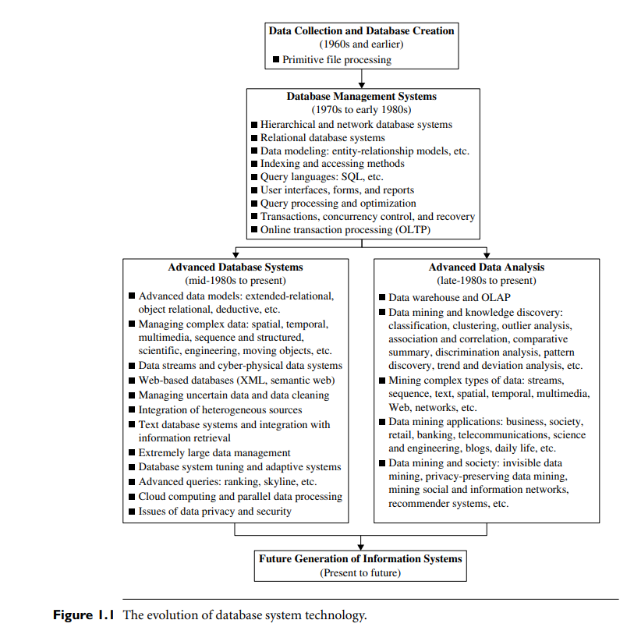
Data Mining as the Evolution of Information Technology

Slide 13
Data Mining as the Evolution of Information Technology
Online Analytical Processing (OLAP)

Slide 14
Data Mining as the Evolution of Information Technology
Online Analytical Processing (OLAP)

Slide 15
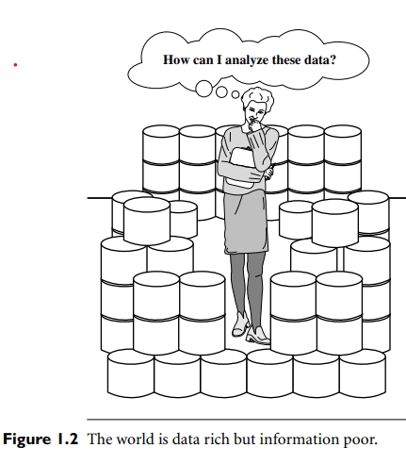
The world is data rich but information poor

Slide 16
Why is Data Mining Important?
Data Mining is also known as Knowledge Discovery from Data (KDD)
Data Mining is the process of discovering meaningful patterns, correlations, and trends by analysing large sets of data.
It uses methods from statistics, machine learning, and database systems.
It's like finding hidden gems or useful knowledge from massive data.

Slide 17
Why is Data Mining Important?
Data Mining Helps us in:
Discover patterns: Find hidden trends and relationships in large datasets.
Make better decisions: Businesses, governments, and scientists use it for smarter decisions.
Predict outcomes: Helps forecast sales, customer behaviour, or risks.
Improve efficiency: Automates analysis of massive data, saving time and resources.
Personalize experiences: Used in recommendations (like Netflix, Amazon, etc.).
Detect fraud or anomalies: Helps spot unusual patterns in finance or cybersecurity.

Slide 18
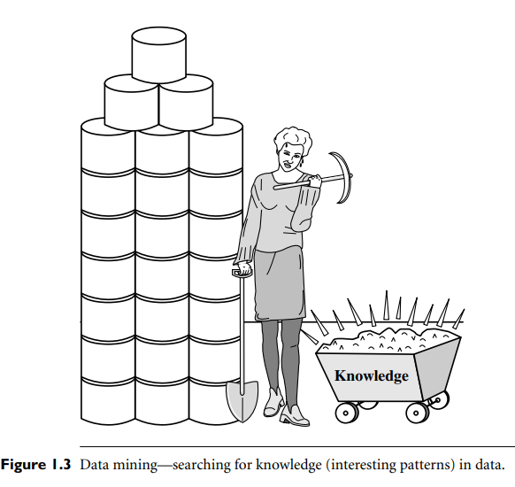
What Is Data Mining?
It is no surprise that data mining, as a truly interdisciplinary subject, can be defined in many different ways. Even the term data mining does not really present all the major components in the picture.
To refer to the mining of gold from rocks or sand, we say gold mining instead of rock or sand mining. Analogously, data mining should have been more appropriately named “knowledge mining from data,” which is unfortunately somewhat long.

Slide 19
What Is Data Mining? Contd..
It is no surprise that data mining, as a truly interdisciplinary subject, can be defined in many different ways. Even the term data mining does not really present all the major components in the picture.
To refer to the mining of gold from rocks or sand, we say gold mining instead of rock or sand mining. Analogously, data mining should have been more appropriately named “knowledge mining from data,” which is unfortunately somewhat long.
However, the shorter term, knowledge mining may not reflect the emphasis on mining from large amounts of data.
Nevertheless, mining is a vivid term characterizing the process that finds a small set of precious nuggets from a great deal of raw material (Figure 1.3).
Thus, such a misnomer carrying both “data” and “mining” became a popular choice.

Slide 20
What Is Data Mining? Contd..
Many people treat data mining as a synonym for another popularly used term, knowledge discovery from data, or KDD, while others view data mining as merely an essential step in the process of knowledge discovery.

Slide 21
What Is Data Mining? Contd..
Many people treat data mining as a synonym for another popularly used term, knowledge discovery from data, or KDD, while others view data mining as merely an essential step in the process of knowledge discovery.
The knowledge discovery process is an iterative sequence of the following steps:
1. Data cleaning (to remove noise and inconsistent data)
2. Data integration (where multiple data sources may be combined)
3. Data selection (where data relevant to the analysis task are retrieved from the database)
4. Data transformation (where data are transformed and consolidated into forms appropriate for mining by performing summary or aggregation operations)
5. Data mining (an essential process where intelligent methods are applied to extract data patterns)
6. Pattern evaluation (to identify the truly interesting patterns representing knowledge based on interestingness measures)
7. Knowledge presentation (where visualization and knowledge representation techniques are used to present mined knowledge to users)

Slide 22
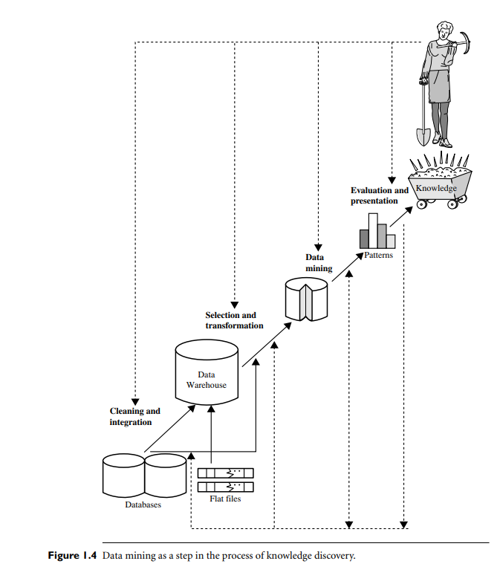
What Is Data Mining? ---How is it Done?
Data Mining follows a process called Knowledge Discovery in Databases (KDD).
Knowledge Discovery Process:
1. Data cleaning
2. Data integration
3. Data selection
4. Data transformation
5. Data mining
6. Pattern evaluation
7. Knowledge presentation
Steps 1 through 4 are different forms of data preprocessing, where data are prepared for mining.
The data mining step may interact with the user or a knowledge base.
The interesting patterns are presented to the user and may be stored as new knowledge in the knowledge base.

Slide 23
Knowledge Discovery (KDD) Process
Knowledge
This is a view from typical database systems and data warehousing communities
Data mining plays an essential role in the knowledge discovery process
Pattern Evaluation
Data Mining
Task-relevant Data
Data Warehouse
Selection
Data Cleaning
Data Integration
Databases

Slide 24
KDD Process: A Typical View from ML and Statistics
Pattern
Information
Knowledge
Input Data
Data Pre-Processing
Data Mining
Post-Processing
Data integration
Normalization
Feature selection
Dimension reduction
Pattern discovery
Association & correlation
Classification
Clustering
Outlier analysis
… … … …
Pattern evaluation
Pattern selection
Pattern interpretation
Pattern visualization
This is a view from typical machine learning and statistics communities

Slide 25
Example: A Web Mining Framework
Web mining usually involves
Data cleaning
Data integration from multiple sources
Warehousing the data
Data cube construction
Data selection for data mining
Data mining
Presentation of the mining results
Patterns and knowledge to be used or stored into knowledge-base

Slide 26
Data Mining in Business Intelligence
Increasing potential
to support
business decisions
End User
Decision Making
Data Presentation
Business
Analyst
Visualization Techniques
Data Mining
Data
Analyst
Information Discovery
Data Exploration
Statistical Summary, Querying, and Reporting
Data Preprocessing/Integration, Data Warehouses
Data Sources
DBA
Paper, Files, Web documents, Scientific experiments, Database Systems

Slide 27
Example: Mining vs. Data Exploration
Business intelligence view
Warehouse, data cube, reporting but not much mining
Business objects vs. data mining tools
Supply chain example: tools
Data presentation
Exploration

Slide 28
Example: Medical Data Mining
Health care & medical data mining – often adopted such a view in statistics and machine learning
Preprocessing of the data (including feature extraction and dimension reduction)
Classification or/and clustering processes
Post-processing for presentation

Slide 29
UNIT - I Introduction to Data Mining
What Data mining?
Kinds of Data,
Knowledge Discovery process,
Data Mining Functionalities,
Kinds of Patterns,
Major Issues in Data Mining.
Data Pre-processing:
Major Tasks in Data Pre-processing,
Data Cleaning,
Data Integration,
Data Reduction,
Data Transformation and Data Discretization.
Data Objects and Attribute Types
Basic Statistical Descriptions of Data,
Data Visualization,
Measuring Data Similarity and Dissimilarity,

Slide 30
Kinds of Data
Text Data
Documents, emails, social media posts.
Example: Customer reviews, news articles, tweets.
Multimedia Data
Images, audio, video.
Example: Face recognition datasets, speech recordings.
Web Data
Internet logs, website structure, and content.
User behavior logs, page links, clickstreams

Slide 31
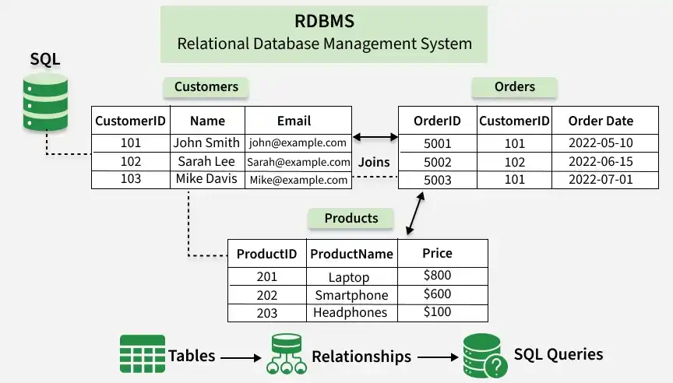
What Kinds of Data Can Be Mined?
Database-oriented data sets and applications
Relational database, data warehouse, transactional database
Relational database: RDBMS stands for Relational Database Management Systems. A database is an organized collection of data stored in a computer system and usually controlled by a database management system (DBMS). It is a program that allows us to create, delete, and update a relational database.
Relational Database Management Systems maintain data integrity by simulating the following features:
Entity Integrity: No two records of the database table can be completely duplicates.
Referential Integrity: Only the rows of those tables can be deleted which are not used by other tables. Otherwise, it may lead to data inconsistency.
User-defined Integrity: Rules defined by the users based on confidentiality and access.
Domain integrity: The columns of the database tables are enclosed within some structured limits, based on default values, type of data or ranges.

Slide 32
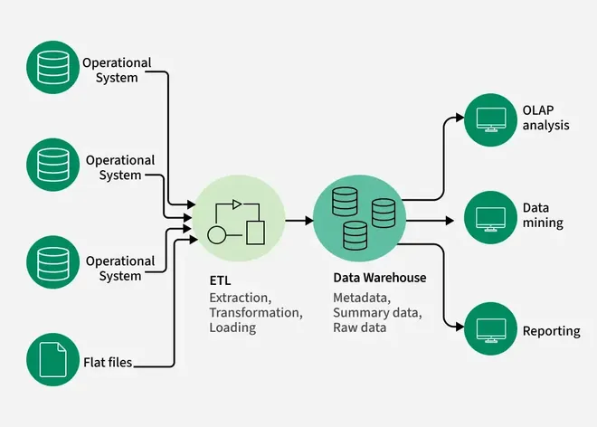
What Kinds of Data Can Be Mined?
Database-oriented data sets and applications
Relational database, data warehouse, transactional database
Data Warehouse: Data warehousing is the process of collecting, integrating, storing and managing data from multiple sources in a central repository. It enables organisations to organise large volumes of current and historical data for efficient querying, analysis and reporting
Need for Data Warehousing:
Handling Large Data Volumes: Traditional databases store limited data (MBs to GBs), while data warehouses are built to handle huge datasets (up to TBs), making it easier to store and analyze long-term historical data.
Enhanced Analytics: Databases handle transactions; data warehouses are optimized for complex analysis and historical insights.
Centralized Data Storage: A data warehouse combines data from multiple sources, giving a single, unified view for better decision-making.
Trend Analysis: By storing historical data, a data warehouse allows businesses to analyze trends over time, enabling them to make strategic decisions based on past performance and predict future outcomes.
Business Intelligence Support: Data warehouses work with BI tools to give quick access to insights, helping in data-driven decisions and improving efficiency

Slide 33
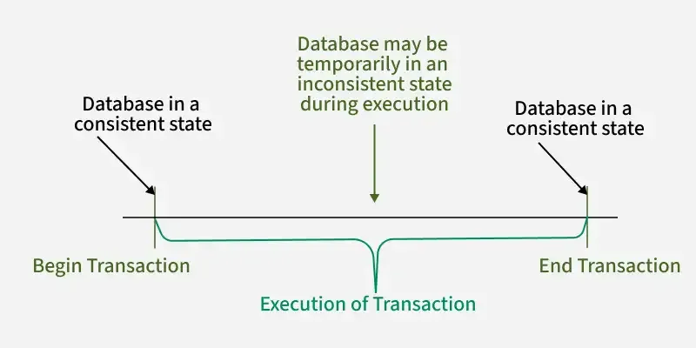
What Kinds of Data Can Be Mined?
Database-oriented data sets and applications
Relational database, data warehouse, transactional database
A transaction refers to a sequence of one or more operations (such as read, write, update, or delete) performed on the database as a single logical unit of work.
A transaction ensures that either all the operations are successfully executed (committed) or none of them take effect (rolled back).
Transactions are designed to maintain the integrity, consistency and reliability of the database, even in the case of system failures or concurrent access.
Example: Let’s consider an online banking application:
Transaction: When a user performs a money transfer, several operations occur, such as:
Reading the account balance of the sender.
Writing the deducted amount from the sender’s account.
Writing the added amount to the recipient’s account.

Slide 34
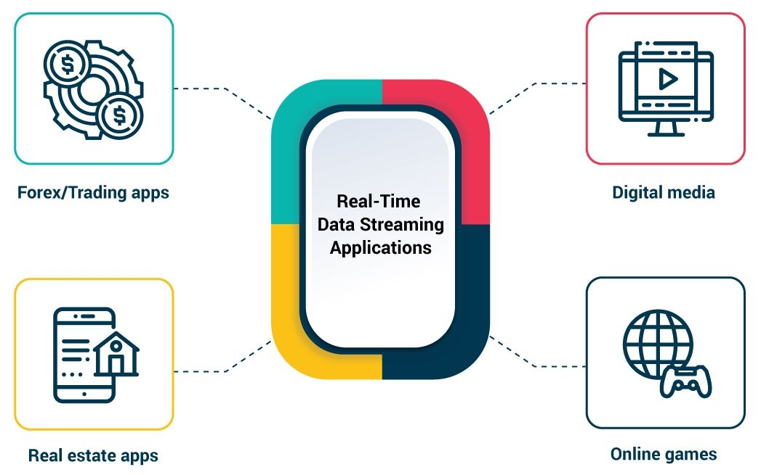
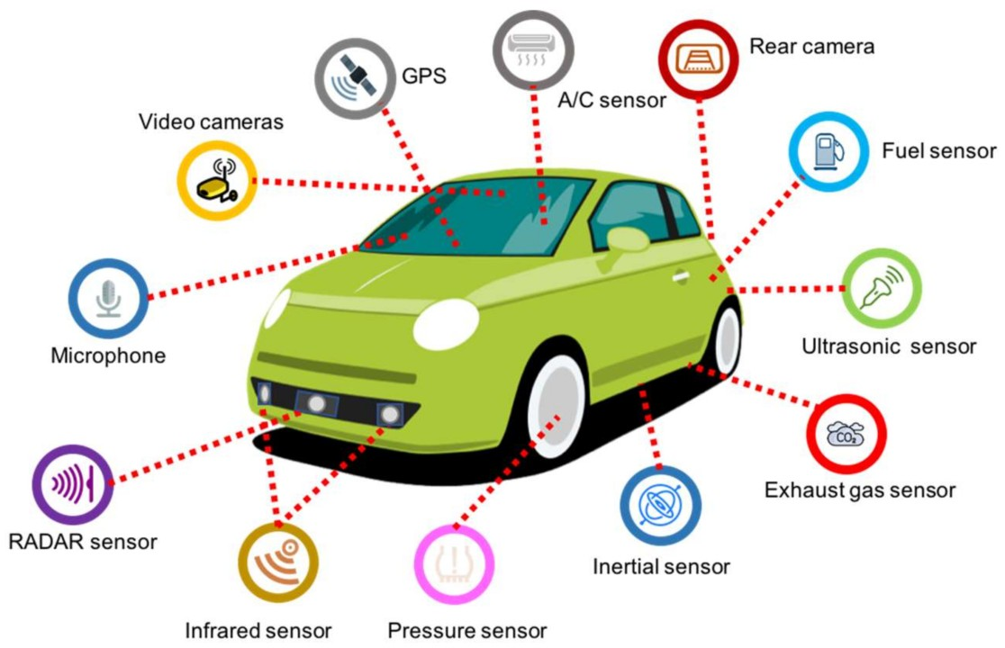
What Kinds of Data Can Be Mined?
Advanced data sets and advanced applications
Data streams and sensor data
Time-series data, temporal data, sequence data (incl. bio-sequences)
Structure data, graphs, social networks and multi-linked data
Object-relational databases
Heterogeneous databases and legacy databases
Spatial data and spatiotemporal data
Multimedia database
Text databases
The World-Wide Web

Slide 35
What Kinds of Data Can Be Mined?
Database-oriented data sets and applications
Relational database, data warehouse, transactional database
Advanced data sets and advanced applications
Data streams and sensor data
Time-series data, temporal data, sequence data (incl. bio-sequences)
Structure data, graphs, social networks and multi-linked data
Object-relational databases
Heterogeneous databases and legacy databases
Spatial data and spatiotemporal data
Multimedia database
Text databases
The World-Wide Web

Slide 36
Data Mining Function: (1) Generalization
Information integration and data warehouse construction
Data cleaning, transformation, integration, and multidimensional data model
Data cube technology
Scalable methods for computing (i.e., materializing) multidimensional aggregates
OLAP (online analytical processing)
Multidimensional concept description: Characterization and discrimination
Generalize, summarize, and contrast data characteristics, e.g., dry vs. wet region
Notes:
I BELIEVE WE MAY NEED TO DO IT IN MORE IN-DEPTH INTRODUCTION, USING SOME EXAMPLES. So it will take one slide for one function, i.e., one chapter we want to cover. Do we need to cover chapter 2: preprocessing and 3. Statistical methods?

Slide 37
Data Mining Function: (2) Association and Correlation Analysis
Frequent patterns (or frequent itemsets)
What items are frequently purchased together in your Walmart?
Association, correlation vs. causality
A typical association rule
Diaper → Beer [0.5%, 75%] (support, confidence)
Are strongly associated items also strongly correlated?
How to mine such patterns and rules efficiently in large datasets?
How to use such patterns for classification, clustering, and other applications?

Slide 38
Data Mining Function: (3) Classification
Classification and label prediction
Construct models (functions) based on some training examples
Describe and distinguish classes or concepts for future prediction
E.g., classify countries based on (climate), or classify cars based on (gas mileage)
Predict some unknown class labels
Typical methods
Decision trees, naïve Bayesian classification, support vector machines, neural networks, rule-based classification, pattern-based classification, logistic regression, …
Typical applications:
Credit card fraud detection, direct marketing, classifying stars, diseases, web-pages, …

Slide 39
Data Mining Function: (4) Cluster Analysis
Unsupervised learning (i.e., Class label is unknown)
Group data to form new categories (i.e., clusters), e.g., cluster houses to find distribution patterns
Principle: Maximizing intra-class similarity & minimizing interclass similarity
Many methods and applications

Slide 40
Data Mining Function: (5) Outlier Analysis
Outlier analysis
Outlier: A data object that does not comply with the general behavior of the data
Noise or exception? ― One person’s garbage could be another person’s treasure
Methods: by product of clustering or regression analysis, …
Useful in fraud detection, rare events analysis

Slide 41
Data Mining Functionalities
Descriptive Functions
These summarize and describe the general properties of data.
Classification: Assign items to predefined categories (e.g., spam or not spam).
Clustering: Group similar data without predefined labels (e.g., customer segments).
Association Rule Mining: Find relationships among items (e.g., if a customer buys bread, they also buy butter).
Summarization: Provide compact descriptions of data (e.g., averages, trends).
Sequence Pattern Mining: Discover patterns in sequences (e.g., buying habits over time).
Predictive Functions
Classification (also predictive): Predict class labels.
Regression: Predict continuous values (e.g., weather prediction).
Time-Series Analysis: Forecast future trends using temporal data. (e.g., stock price prediction)

Slide 42
Types of Data
Structured Data
Clearly defined format (tables, rows, columns).
Example: Databases (SQL), Excel files, CSV files etc.
Unstructured Data
No predefined format or organization.
Example: Text documents, images, videos, audio.
Semi-Structured Data
Partially organized with tags or markers.
Example: XML, JSON, HTML pages.
Quantitative Data
Numerical, measurable values.
Example: Age, salary, temperature.
Qualitative (Categorical) Data
Descriptive labels or categories.
Example: Gender, product type, city names.
Binary Data
Two possible values: 0/1, Yes/No.

Slide 43
Kinds of Patterns
Association Patterns
Discover relationships or co-occurrences among items.
Example: Customers who buy tea also buy sugar.
Classification Patterns
Assign data to predefined classes.
Example: Email classified as spam or not spam.
Clustering Patterns
Group similar data without labels.
Example: Market segments based on shopping behavior.
Sequential Patterns
Find patterns in ordered events or actions.
Example: A person buys a phone → then a cover → then a charger.
Regression Patterns
Predict continuous numeric values.
Example: Predicting temperature.
Outlier/Anomaly Patterns
Identify rare or abnormal data points.
Example: Unusual credit card transactions.

Slide 44
Major Issues in Data Mining (1)
Mining Methodology
Mining various and new kinds of knowledge
Mining knowledge in multi-dimensional space
Data mining: An interdisciplinary effort
Boosting the power of discovery in a networked environment
Handling noise, uncertainty, and incompleteness of data
Pattern evaluation and pattern- or constraint-guided mining
User Interaction
Interactive mining
Incorporation of background knowledge
Presentation and visualization of data mining results

Slide 45
Major Issues in Data Mining (2)
Efficiency and Scalability
Efficiency and scalability of data mining algorithms
Parallel, distributed, stream, and incremental mining methods
Diversity of data types
Handling complex types of data
Mining dynamic, networked, and global data repositories
Data mining and society
Social impacts of data mining
Privacy-preserving data mining
Invisible data mining

Slide 46
Major Issues in Data Mining
Data Quality
Incomplete, noisy, or inconsistent data affects accuracy.
Needs cleaning before mining.
Scalability
Algorithms must handle huge datasets efficiently.
High Dimensionality
Many attributes (features) can make analysis complex and slow.
Data Integration
Combining data from different sources can be difficult due to format differences.
Privacy and Security
Sensitive data (like health or finance) must be protected during mining.
Mining Dynamic Data
Real-time or constantly changing data requires adaptive methods.
Interpretability
Patterns found must be easy to understand and useful for decision-making.

Slide 47
THANK YOU

